Slide 1
Diksha Infra Scaling - 2020

Slide 2
Table of Contents
Service level improvements
Optimizations on Portal
Data Infrastructure
Infrastructure improvements
Soak test results

Slide 3
Learner Service Improvements
API | Thread Count | Samples | Before Throughput/sec | After Throughput/sec
Root Org Search | 300 | 1500000 | 665.2 | 1797.9
Location Search | 300 | 2250000 | -NA- | 3554.7
Location Search -District | 300 | 2250000 | -NA- | 3638.6
Channel Read | 300 | 1500000 | -NA- | 40295.5
Get System Settings | 200 | 2000000 | 709.2 | 15622
Code and infra changes
Fixed memory leak issue
Code changes for telemetry generation
Removed Lmax which causing high cpu usage and implemented logback kafka appender for telemetry push
Added Java memory configuration at service startup time
After applying the fixes last week, we did not see any pod restart or errors from the service
Notes:
SV

Slide 4
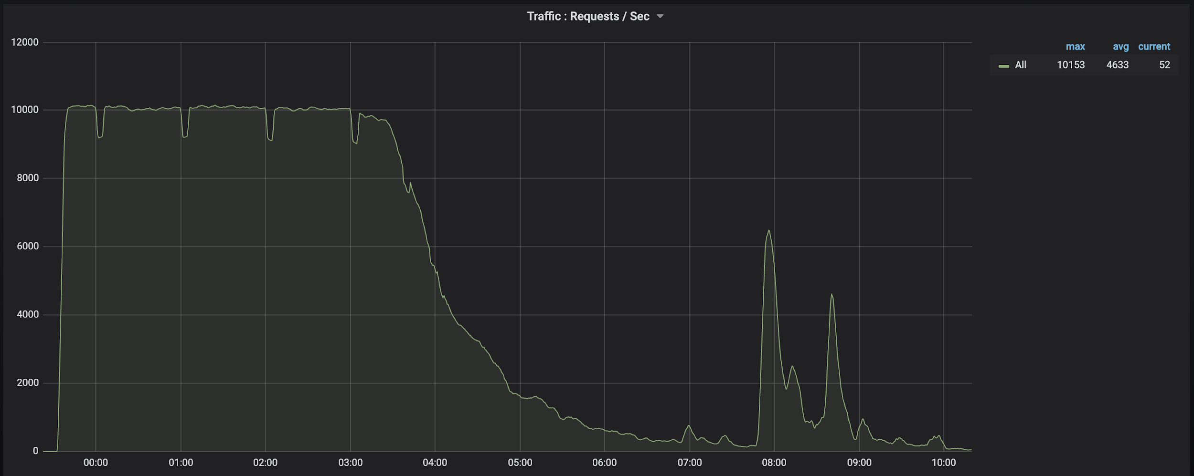
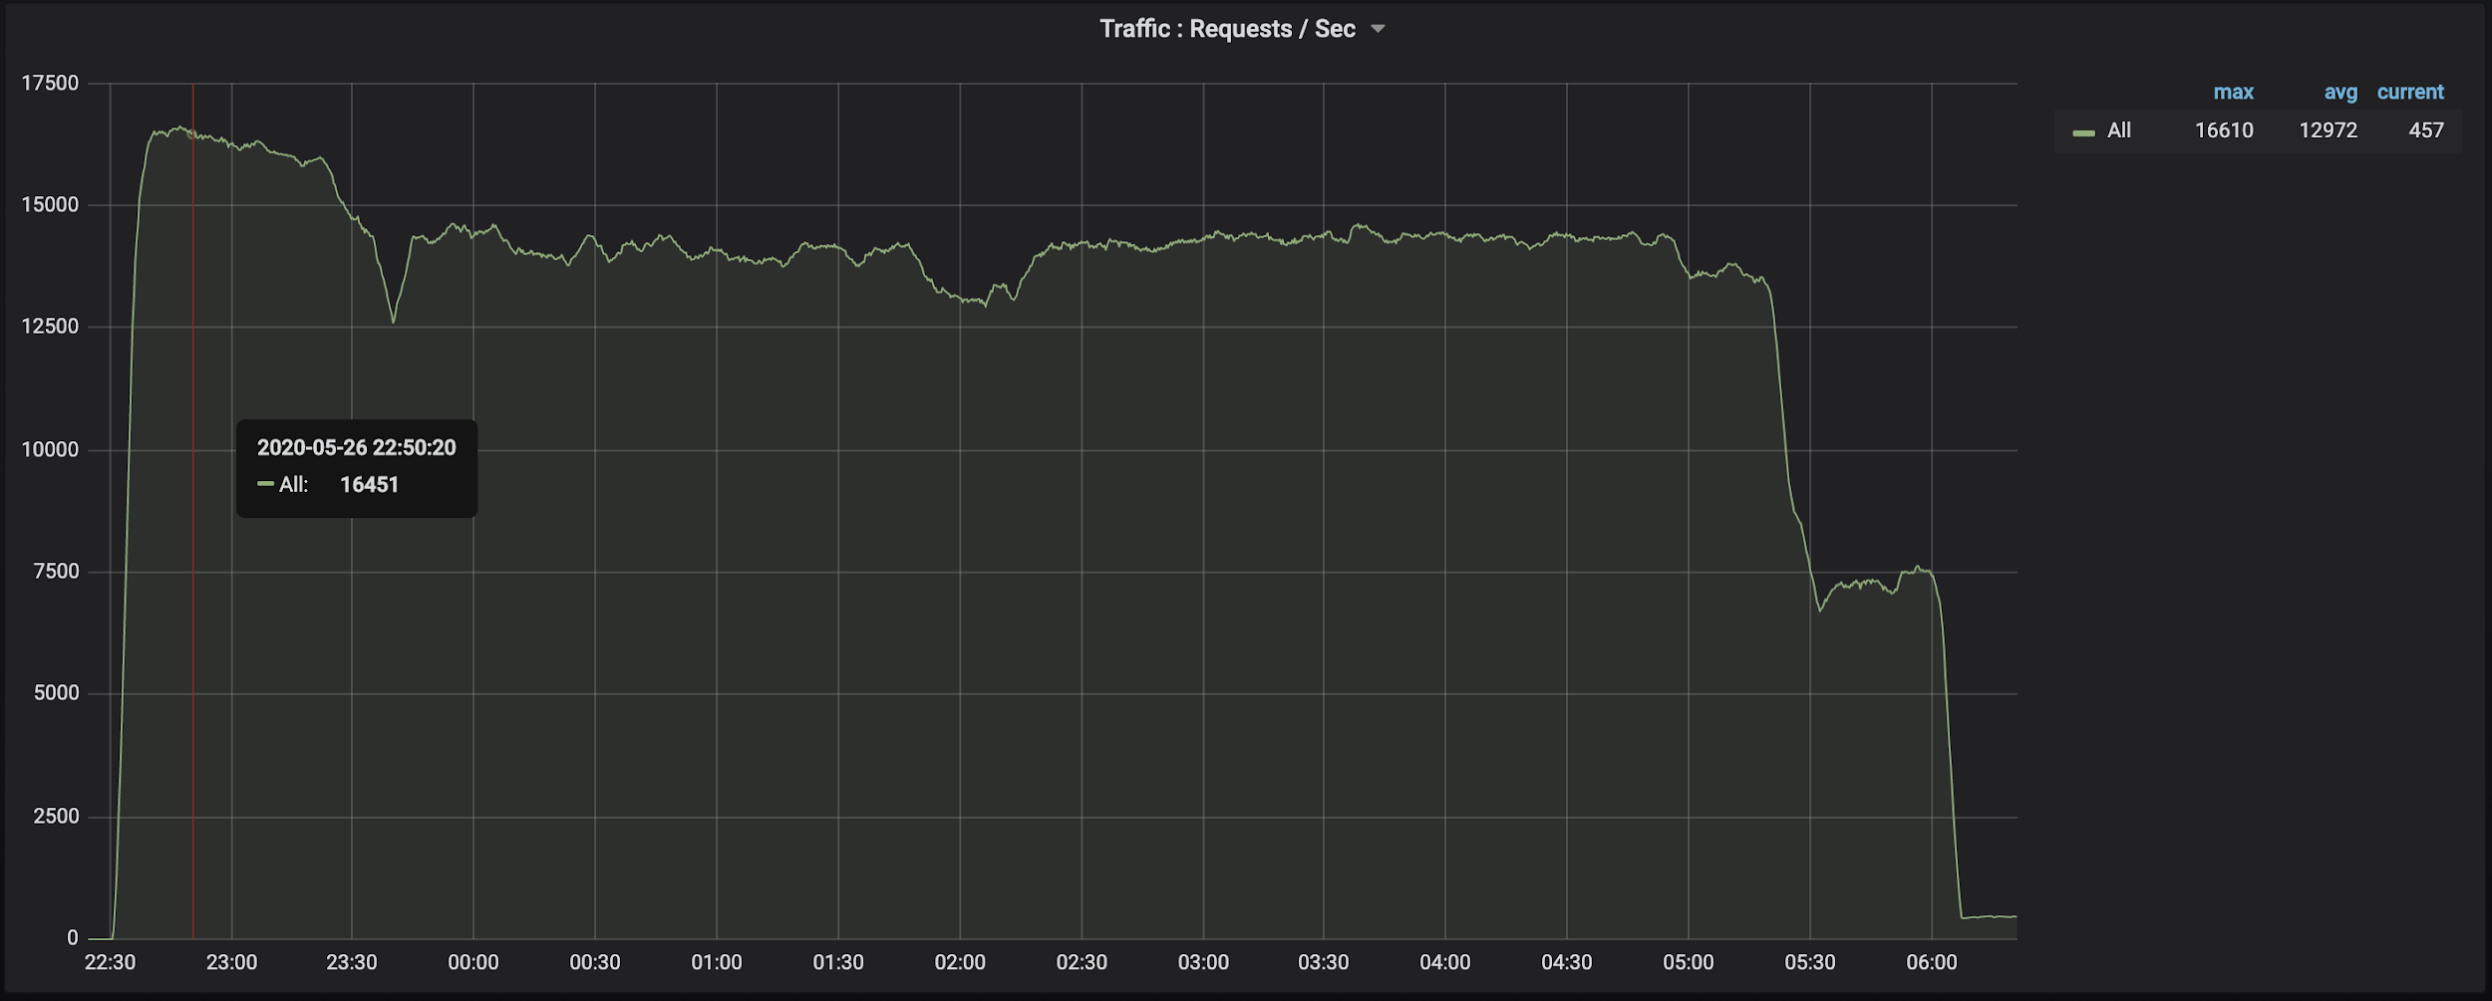
Learner Service - Soak Test Run Comparison
Before Max Memory Used - 4 GB
After Max Memory Used - 1.6 GB
Notes:
SV

Slide 5
LMS Service Improvements
API | Thread Count | Samples | Before Throughput/sec | After Throughput/sec
Framework Read w/o categories | 200 | 400000 | 1221.2 | 1221.2
Open Batch Enroll | 200 | 4000000 | 567.6 | 771.5
Learner State Update | 200 | 4000000 | 1043.1 | 1189.7
User Enrollment List | 200 | 2000000 | 265.02 | 853.9
Framework Read with categories | 200 | 7200000 | -NA- | 6159
Code and infra changes
Fixed a memory leak issue, which was the root cause of 5XX errors during high load.
Optimised courseEncrollmentList by reducing the number of calls to search-service
Added java memory configurations at service startup time
With course enrollment API code changes, we achieved 3x improvement in throughput
No pod restarts and HTTP errors after the changes
Notes:
-SV

Slide 6
Course Batch Updater Improvements
Scenario | Samza Containers | Throughput | Infra Observations | Max Accumulated Lag
Before | 16 containers | 1k per min per container (16k per minute) | ES load - 77%, Cassandra Load - 20% 16k writes per min on ES & Cassandra | 400K
 | 32 containers | 1k per min per container (32k per minute) | ES load - 89%, Cassandra Load - 19% 32k writes per min on ES & Cassandra | 200K
After | 8 containers | 10k per min per container (80k per minute) | ES load - 35%, Cassandra Load - 56% 320 writes per min on ES(16 core) & Cassandra | No Lag as the max producer throughput is 72k/minute -
 | 16 containers | 10k per min per container (160k per minute) | ES load - 34%, Cassandra Load - 78% 640 writes per min on ES(16 core) & Cassandra
With Soak Test | 16 containers | 8-9k per min per container (70k per minute) | ES load - 40%, Cassandra Load - 77.4% 280 writes per min on ES & Cassandra | 72k

Slide 7
Course Batch Updater - Enabled Batching & Caching
Reduced the calls to content read API to fetch course metadata, by caching required metadata with ttl of 1hr.
Single session/connection for cassandra (with consistency level set to QUORUM)
Single connection to Redis. This reduces the time consumed in opening and closing connections for every event processing.
Instead of processing course progress events one by one, introduced batch processing (windowing) of events with batch size of 250.
Reduced the number of writes to both ES & Cassandra
Next Steps
ES is not designed for massive writes as Cassandra and will always throttle the throughput of the job. To go to 2x of the throughput we have to scale ES and this is not sustainable in long run
We have to move away from ES as Cassandra is capable to serve read requests at the desired throughput, as the queries fired are only key based lookups

Slide 8
Analytics Service
Scenario | API | Thread Count | Samples | Error Count | Avg (ms) | 95th pct | 99th pct | Throughput/sec
Before | Device Profile | 200 | 100000 | 0 | 281 | 605 | 632 | 699.6
 | Device Register | 200 | 100000 | 0 | 341 | 718 | 745 | 578.7
After | Device Profile | 200 | 500000 | 0 | 70 | 44 | 62 | 2692.7
 | Device Register | 200 | 500000 | 0 | 80 | 110 | 208 | 2440.1
Code and infra changes:
Identified that the actor configuration is not reading from the given config file and only one actor is instantiated
Fixed the actor configuration
Notes:
Anand P

Slide 9
Search Service Findings
Scenario | Findings
Dial Search API | 2000 tps
BGMS Query (Library Page on Mobile & Portal) | 300 tps ES CPU Load - 90%
BGMS Query optimizations (To use filters and terms) | 900 tps ES CPU Load - 40%
BGMS Query
{
"offset": 0,
"limit": 100,
"mode": "hard",
"facets": ["subject"],
"sort_by": {"name": "asc"},
"filters": {
"compatibilityLevel": {"min": 1,"max": 4},
"objectType": ["Content"],
"contentType": ["TextBook"],
"gradeLevel": ["Class 1"],
"medium": ["English"],
"board": ["State (Andhra Pradesh)"]
}
}
Findings
Search API is generating a full text search query even for simple BGMS filter query
All terms like Board/Medium/Grade/Channel are indexed with analyzers
Next Steps
Optimized the index mapping
Create v4 version of the search API to generate optimized queries

Slide 10
Portal Load @1mbps speed: Before and After Optimization
Page | DOM Content load | First Contentful Paint | First Meaningful paint | Time to interactive | Data Transferred | No of API called | Total Time to Load
Login | 7 sec | 7.2 sec | 7.3 sec | 8 sec | 1 mb | 1 | 9 sec
SignUp | 6.5 sec | 7 sec | 7.7 sec | 7.9 sec | 1.3 mb | 8 | 14 sec
Course Player | 6.5 sec | 7 sec | 7.7 sec | 14 sec | 1.3 mb | 20 | 33 sec
Training | 6.5 sec | 7 sec | 7.7 sec | 9 sec | 1.3 mb | 14 | 13 sec
Library | 6.5 sec | 7 sec | 7.7 sec | 9 sec | 1.3 mb | 14 | 13 sec
Page | DOM Content load | First Contentful Paint | First Meaningful paint | Time to interactive | Data Transferred | No of API called | Total Time to Load
Login | 3 sec | 3.2 sec | 3.2 sec | 3.2 sec | 150 kb | 1 | 3.2 sec
SignUp | 5.2 sec | 5.5 sec | 5.7 sec | 6.5 sec | 900 kb | 5 | 10 sec
Course Player | 5.2 sec | 5.4 sec | 5.6 sec | 10 sec | 950 kb | 16 | 28 sec
Training | 6.5 sec | 7 sec | 7.7 sec | 9 sec | 900 kb | 10 | 10 sec
Library | 6.5 sec | 7 sec | 7.7 sec | 9 sec | 900 kb | 10 | 10 sec
Notes:
Santhosh G - Format

Slide 11
Portal - Load improvements on top used pages
Code level changes
Lazy loading modules based on route
Removed unused API calls and calling them when required
Calling API with required fields
Removed unused libraries and Lazy loading them when required
Reduced Main.js size by Re-Organizing Core and Shared Module
SignUp and Login Page POC without Angular with only Jquery Ajax and Telemetry library.
Replaced Heavyweight libraries with Lightweight libraries. Like Moment with DayJs
Component caching using Angular RouteReuseStrategy
Infra level changes
Caching Master Data API’s at Proxy.
Caching and Gziping Assets (JS, CSS) at Proxy.
Gziping API’s response.
Next Steps
Angular core library is very large and Loading this along with other libraries takes 3-4 sec.
Core and Shared Modules need to be decoupled and loaded when required.
Reduce use of Third Party libraries and Move to Common Consumption library.
Get the top ten pages lighthouse audit score to at least 80%
Notes:
Santhosh G

Slide 12
Load test results - Master data caching at proxy
Scenario | API | Thread Count | Samples | Error Count | Avg (ms) | 95th pct | 99th pct | Throughput/sec
Before | Framework Read | 200 | 200000 | 0 | 2356 | 5516.95 | 6664.98 | 82.8
 | Framework Read with categories | 200 | 200000 | 0 | 334 | 88 | 9074.51 | 508.7
After | Framework Read | 200 | 400000 | 0 | 135 | 368.95 | 855.99 | 1221.2
 | Framework Read with categories | 200 | 7200000 | 0 | 24 | 33 | 235.98 | 6159
Notes:
Santhosh G

Slide 13
Portal - Master data caching at proxy
Caching Frequently used Master Data at Proxy reduces load on APIs and reduces response time. The cache would also handle 304 (not modified) if the same client (etag, if-modified-since) makes a second request for the same API and if the cache entry has not changed thus reducing data transfer too.
Below API’s are cached at Proxy with ttl of 1 hour
Framework Read
Channel Read
Role Read
System Settings
Tenant Info
Resource Bundles
Notes:
Santhosh G

Slide 14
Portal - Build time optimizations
Portal Build taken around 30+ min. All steps run in sequential order. Below changes are done to reduce build under 8 min.
Combine Portal build job and Portal CDN build job. Save 5+ min.
Use Yarn instead of NPM to resolve dependency. 30% faster without caching and 90% faster with caching. Saves 2+ min
Remove Editor dependency and load them from Blob or CDN like player.
Run Server, Client CDN and Client Docker copy build in parallel. Then build docker image from Server and Docker Client build. Saves 5+ min.
Clone only Tenant repo and remove Devops repo dependency for Player custom(Tenant) builds.
Cache cloned repos and Node modules for subsequent builds.
Next Target - To reduce 8 to 5 mins
Notes:
Santhosh G

Slide 15
Portal - SignUp pages POC
Portal SignUp Page is built using Angular. Angular is very Heavyweight. Along with Angular some other libraries and Portal code were also loaded in SignUp page. Because of this SignUp Page was Taking 7-8 sec to load at 1 Mbps speed.
We created a simple HTML page with just Jquery ajax and telemetry library. With this changes SignUp page was loading in less than 2 Seconds.
 | DOM Content load | First Contentful Paint | First Meaningful paint | Time to interactive | Data Transferred | No of API called
With Angular | 7 sec | 7.2 sec | 7.3 sec | 8 sec | 1 mb | 1
Without Angular | 2 sec | 2 sec | 2 sec | 2 sec | 100 kb | 1
Notes:
Santhosh G

Slide 16
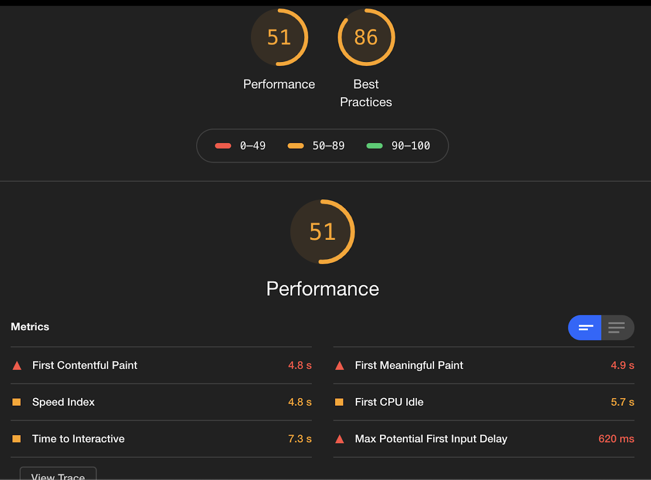
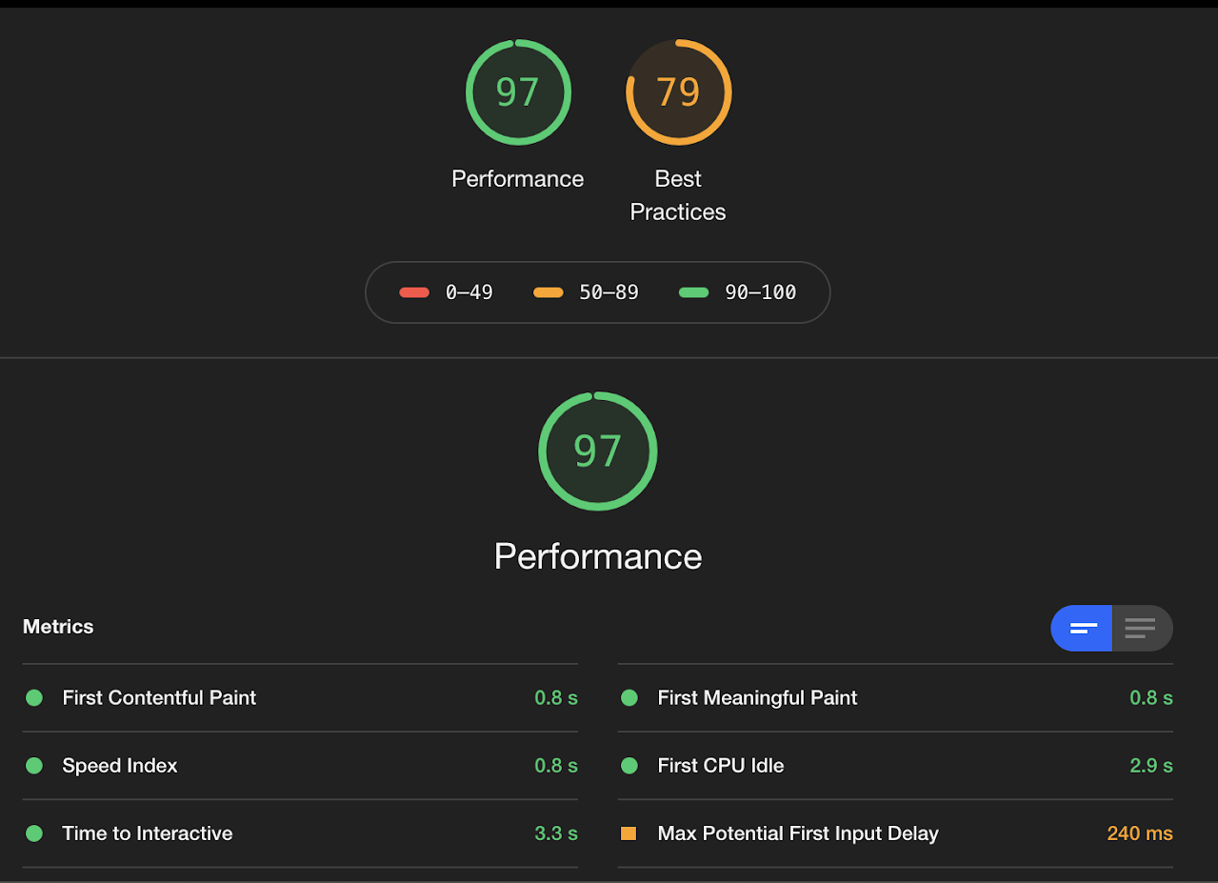
SignUp page - Before & After

Slide 17
Data Infrastructure - Kafka - 1B events/day
Parameter | Optimization | Before Optimization | After Optimization
Disk configuration | Data disk | 2 TB disk size limit | 64 TB disk size limit
Kafka Service boot up time | Standard SSD | 1 hour | 5 minutes
File descriptors | Segment size 1GB | 18,000 | 140,000
Data compression - Disk usage | Snappy | 100% | 35%
Replication threads | 4 | 20 minutes for 16 gb partition | 17 minutes for 16gb * 4 partitions
Kafka version | 2.4.1 | 166 gb replication took 2:50 hrs | 166 gb replication took 1:55 hrs
Kafka service shutdown timeout | Increased to 5 mins | Unclean shutdown leads to rebuilding of segments | Segments get flushed to disk and no rebuilding required
Scaling
Scaled from 3 node to 5 node Kafka cluster by setting up a parallel pipeline.
Scaled from 5 node to 7 node Kafka cluster by adding additional broker nodes and rebalancing data.
Separate Zookeeper cluster outside of brokers.
Separate Ingestion and Processing Kafka clusters
Notes:
Anand P

Slide 18
Data Infrastructure - Druid
Cluster scaling
Separate MiddleManager nodes for ingestion of raw telemetry data and roll-up data.
Use syncts as the primary timestamp column instead of ets.
Ensure that all dashboards and reports use the roll-up data sources to speed up queries.
Optimize the segment cache size so that the frequently used segments are cached. No restarts of the Historical nodes observed.
Ingestion Benchmarking
Data size | Input partitions | No. of workers | Heap size | Raw Telemetry | Roll-up Telemetry
100 Million | 4 | 2 | 4 gb | 22 million/hr | 54 million/hr
100 Million | 8 | 8 | 4 gb | 57 million/hr | N/A
1 Billion | 16 | 16 | 4 gb | 107 million/hr | N/A
1 Billion | 4 | 4 | 4 gb | N/A | 84 million/hr
Notes:
Anand P

Slide 19
Data Infrastructure - Course Reports
Data product | No. of users | Machine configuration | Before optimization | After optimization
Course Metrics | 2 million | 16 cores, 60 gb | 29 minutes | 11 minutes
Assessment Metrics | 2 million | 16 cores, 60 gb | 65 minutes | 18 minutes
Optimizations
Load only required fields for computation from the source Cassandra tables.
Cache intermediate Spark dataframes which is used in the downstream computations. This reduces the recomputation of the entire DAG by Spark.
Optimize the data inserts into Elastic search for Course and Assessment dashboards.
Notes:
Anand P

Slide 20
Data Infrastructure - Workflow Summarizer
Data size | Execution configuration | Optimization | Before Optimization | After Optimization
250M | Cores: 30, Memory: 110g | Kryo Serializer | 56 mins | 41 mins
250M | Cores: 30, Memory: 110g | Use JSON String instead of Object | 56 mins | 21 mins
500M | Cores: 60, Memory: 220g | Use JSON String instead of Object | 1 hour 25 mins | 47 mins
750M | Cores: 60, Memory: 220g | Use JSON String instead of Object | 2 hours 47 mins | 1 hour 52 mins
1 Billion | Cores: 60, Memory: 220g | Use JSON String instead of Object | N/A | 6 hours 58 mins
Optimizations
Use KryoSerializer instead of the Java serializer
Use Stringified JSON of the telemetry instead of POJO/Case Class of the Telemetry events.
Use a higher batch size for the Kafka Dispatcher and snappy compression when dispatching events to Kafka.
Use optimal number of partitions (parallelization in Spark) to achieve better performance.
Next Steps
Parallelize using partitions
Notes:
Anand P

Slide 21
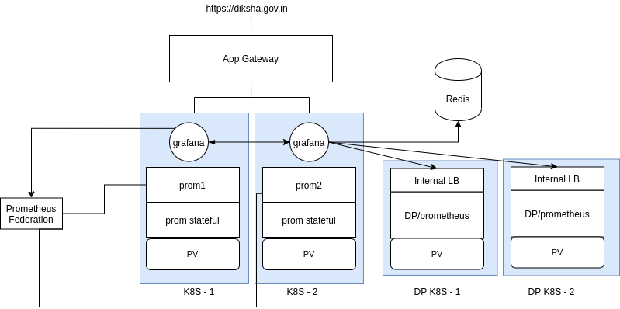
Infrastructure - Multi K8S for resiliency
Notes:
Santhosh G
Multiple Kubernetes Cluster for resiliency and ops efficiency
Application Gateway as Frontend
Zero downtime Cluster upgradation, Application Deployment
Will remove one cluster from the backend and do operations
AutoScaling ApplicationGateway instances (0 - 125)
We’ll have (2-125) scaling for initial traffic flow
Zone Redundant Deployment
Can have zone redundant appgateway deployment which spans across multiple zones
Backend pools( k8s clusters) can also be in different zones, hence provided with zone failure resiliency

Slide 22
Infrastructure Improvements
Upgraded kong version from 0.9 to 0.10
Soak test max TPS in kong 0.9 - 7332 req/s, TPS in kong 0.10 - 14244 req/s
Logging ES cluster
Current configuration - Single node F16s ( 16 core 16G) 2TB HDD; 600G data per day; Retention 2 days
New Configurations - 3 node cluster with fluent bit
Updated replication factor for sunbird_courses Cassandra keyspace for improved resiliency

Slide 23
Soak Test Results Before Optimizations:
API | Thread Count | Samples | Error Count | Avg (ms) | 95th pct | 99th pct | Throughput/sec
Total |  | 2400000 | 0 | 159.12 | 395 | 718.97 | 3543.49
Content Hierarchy | 600 | 300000 | 0 | 262.74 | 896.85 | 1433.98 | 443
Content Read | 600 | 300000 | 0 | 165.05 | 626 | 1083.99 | 443.05
Device Register | 600 | 300000 | 0 | 63.06 | 104 | 144 | 443.05
Dial Search | 600 | 300000 | 0 | 129.51 | 508 | 833.98 | 443.05
Form Read | 600 | 300000 | 0 | 79.39 | 297 | 458 | 443.05
Org Search | 600 | 300000 | 0 | 231.01 | 859 | 1276.99 | 443.05
Send Telemetry | 600 | 300000 | 0 | 270.63 | 716 | 1287.99 | 443.03
Tenant Info | 600 | 300000 | 0 | 71.61 | 261 | 393.99 | 443.04
12 node Kubernetes cluster, Standard D4SV3
Proxy - 12 (cpu limit - 1 core, memory limit - 1GB)
Kong - 6 (cpu limit - 1 core, memory limit - 1GB)
Player - 8 (cpu limit - 1.5 core, memory limit - 1GB)
KnowledgeMW - 8 (cpu limit - 2 core, memory limit - 4GB)
Content - 6 (cpu limit - 2 core, memory limit - 4GB)
LMS - 6 (cpu limit - 2 core, memory limit - 4GB)
Learner - 6 (cpu limit - 3 core, memory limit - 4GB)
Telemetry 6 (cpu limit - 1.5 core, memory limit - 1GB)

Slide 24
Soak Test Results After Optimizations
API | Thread Count | Samples | Error % | Avg (ms) | 95th pct | 99th pct | Throughput/sec
Total |  | 360700000 | 0.00% | 280.5 | 407 | 542 | 14244.32
Content Read | 1575 | 37800000 | 0.00% | 143.8 | 56 | 68 | 1394.22
Form Read | 1050 | 25200000 | 0.00% | 25.83 | 11 | 51 | 929.48
Read Framework | 1050 | 25200000 | 0.00% | 13.74 | 2 | 51 | 929.49
Send Telemetry | 1575 | 37800000 | 0.00% | 204.78 | 67 | 614 | 1394.24
Content Hierarchy | 525 | 39375000 | 0.00% | 278.53 | 185 | 330 | 1595.37
Org Search | 525 | 39375000 | 0.00% | 20.86 | 15 | 55 | 1595.37
Read Framework | 525 | 39375000 | 0.00% | 23 | 74 | 292 | 1595.38
Tenant Info | 525 | 39375000 | 0.00% | 2.85 | 4 | 9 | 1595.38
Dial Assemble | 200 | 10800000 | 0.00% | 186.05 | 399 | 534 | 466.57
Get User Profile V2 | 400 | 21600000 | 0.00% | 52.63 | 74 | 498.99 | 933.15
Page Assemble | 200 | 10800000 | 0.00% | 133.28 | 345 | 486 | 466.58
Login Workflow (1st API call) | 40 | 1000000 | 0.02% | 136.83 | 246 | 298 | 35.38
Login Workflow (2nd API call) | 40 | 1000000 | 0.00% | 55.62 | 52 | 93 | 35.38
Login Workflow (3rd API call) | 40 | 1000000 | 0.02% | 266.19 | 366 | 418.99 | 35.38
Login Workflow (4th API call) | 40 | 1000000 | 0.07% | 663.34 | 879 | 1012 | 35.38
Learner State Update | 200 | 30000000 | 0.00% | 64.48 | 75 | 100 | 1207.61

Slide 25
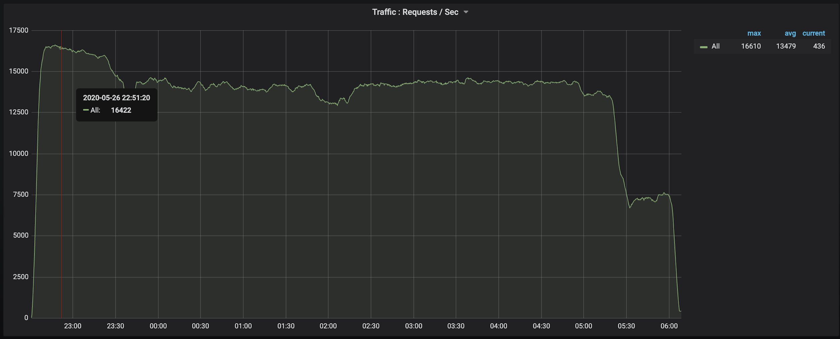
Soak Test Results After Optimizations:

Slide 26
Infrastructure changes:
18 node K8S cluster, Standard F8s (8 vcpus, 16 GiB memory)
Proxy - 18 (cpu limit - 0.8 core, memory limit - 0.8GB)
Kong - 8 (cpu limit - 1.5 core, memory limit - 1GB)
Player - 8 (cpu limit - 1 core, memory limit - 1GB)
KnowledgeMW - 15 (cpu limit - 1 core, memory limit - 1.5GB)
Content - 8 (cpu limit - 1 core, memory limit - 2GB)
LMS - 8 (cpu limit - 2 core, memory limit - 3GB)
Learner - 8 (cpu limit - 1 core, memory limit - 2.5GB)
Telemetry 12 (cpu limit - 1 core, memory limit - 1GB)
Configure max heap memory while bootstrapping the learner and lms services
Kong version upgrade to 0.10
Cached Master Data API’s at proxy
Updated lms-es instance type to F16sV23 and Disk
Cassandra keyspace replication factor

Slide 27
Next Sprint Items
Horizontal scaling of Databases
Cassandra
Elastic Search
Keycloak scaling
Telemetry shaping
Productionizing Kong 10 with JWT plugin changes
Productionizing Flink
WFS Parallelization
Druid query benchmarking
Notes:
Santhosh G/Anand P

Slide 28
Thank You

Slide 29
Infrastructure used during this Optimizations:
Container Details:
Kubernetes cluster of type Virtual Machine Scale Sets (VMSS) with 18 Nodes - Standard F8s (8 vcpus, 16 GiB memory) on Azure
In AKS, Azure CNI networking was used
A subnet with a CIDR /22 in the VNET was created for AKS cluster
In Azure CNI, every pod gets a IP directly from the subnet
There is no NAT between Kubernetes pods and nodes (Kubernetes nodes / External nodes)
You will be able to directly connect to the pod using the pod ip
If you inspect the traffic to / from pods, you will see the IP of the pod as source / destination and not the node in which it is running (there is no NAT between pod and node)
For more information on Azure CNI, please visit - https://docs.microsoft.com/en-us/azure/aks/configure-azure-cni
All the 18 nodes were used to invoke the service from Jmeter in round robin
Proxy - 18 (cpu limit - 0.8 core, memory limit - 0.8GB)
Kong - 8 (cpu limit - 1.5 core, memory limit - 1GB)
Player - 8 (cpu limit - 1 core, memory limit - 1GB)
KnowledgeMW - 15 (cpu limit - 1 core, memory limit - 1.5GB)
Content - 8 (cpu limit - 1 core, memory limit - 2GB)
LMS - 8 (cpu limit - 2 core, memory limit - 3GB)
Learner - 8 (cpu limit - 1 core, memory limit - 2.5GB)
Telemetry 12 (cpu limit - 1 core, memory limit - 1GB)

Slide 30
Benchmarking 8 commonly used API's during consumption via Proxy and API Manager:
APIs Invoked in this benchmarking:
API Name | API path | Description
Content Read | /api/content/v1/read/ | GET API call is used to read the content’s details
Content Hierarchy | /api/course/v1/hierarchy/ | GET API call is used to read any content hierarchy details
Form Read | /api/data/v1/form/read | POST API call is used to read the form configuration details
Page Assemble | /api/data/v1/page/assemble | POST API call used to display relevant contents on explore page or post login page
Org Search | /api/org/v1/search | POST API call used to read a organisation based on channel id
Send Telemetry | /api/data/v1/telemetry | POST API call which sends telemetry data with compressed payload
Tenant Info | /v1/tenant/info | GET API call used to read tenants based on tenant id
Read Framework | /api/framework/v1/read/ | GET API call used to read a specific framework’s details

Slide 31
Optimizations:
Code level changes:
Infra level changes:
Result Analysis & findings:

Slide 32
Report - After Optimizations:

Slide 33
Benchmarking Top 11 Individual APIs:
APIs Invoked in this benchmarking:
API | API path | Description
Content Read | /api/content/v1/read/ | GET API call used to read the content’s details
Composite Search | /api/composite/v1/search | POST API call used to search content based on the dialcode
Device Profile | /api/user/v2/read/ | GET API call is used to ge get the device profile data
Dial Search | /api/data/v1/dial/assemble | POST API call used to search dial codes based on QR code
Get System Settings | /api/data/v1/system/settings/list | GET API is used to read the system setting specific value
Org Search | /api/org/v1/search | POST API call used to read a organisation based on channel id
Page Assemble | /api/data/v1/page/assemble?orgdetails=orgName,email | POST API call used to display relevant contents on explore page or post login page
Read Framework | /api/framework/v1/read/ | GET API call used to read a specific framework’s details
Read Form | /api/data/v1/form/read | POST API call used to read forms
Telemetry | /api/data/v1/telemetry | POST API call which sends telemetry data with compressed payload
User Profile | /api/user/v2/read/ | GET API call is used to get the user profile data

Slide 34
Optimizations:
Code level changes:
Infra level changes:
Result Analysis & findings:

Slide 35
Report - after optimizations:
API | Thread Count | Samples | Error Count | Avg (ms) | 95th pct | 99th pct | Throughput/sec
Content Read | 200 | 1000000 | 460 | 21 | 53 | 59 | 7221.4
Composite Search | 200 | 3000000 | 0 | 165 | 198 | 213 | 1185.1
Device Profile | 200 | 810000 | 0 | 335 | 522 | 618 | 581.8
Dial Search | 600 | 600000 | 0 | 496 | 670 | 1196.99 | 1133.2
Get System Settings | 200 | 2000000 | 0 | 9 | 7 | 52 | 15622
Org Search | 300 | 1500000 | 0 | 35 | 59 | 68 | 1797.9
Page Assemble | 600 | 600000 | 0 | 1280 | 3303 | 4353.97 | 445
Read Framework | 200 | 7200000 | 0 | 24 | 33 | 235.98 | 6159
Read Form | 100 | 810000 | 0 | 38 | 66 | 162 | 2396.6
Telemetry
User Profile | 125 | 750000 | 0 | 40 | 62 | 225 | 2686.1

Slide 36
LMS APIs Benchmarking:
APIs Invoked in this benchmarking:
API Name | API path | Description
Framework Read | /api/framework/v1/read | GET API call used to read the framework details based on the framework Id
Open Batch Enroll | /api/course/v1/enrol | POST API call is used to enroll user to an open batch
Learner State Update | /api/course/v1/content/state/update | POST API call used to update content status from a course batch
User Enrollment List | /learner/course/v1/user/enrollment/list | GET API call used to read the course enrollment list based on user id

Slide 37
LMS APIs- Benchmarking Before Optimizations:
Before Optimization:
API | Thread Count | Samples | Error Count | Avg (ms) | 95th pct | 99th pct | Throughput/sec
Framework Read w/o categories | 200 | 200000 | 0 | 2356 | 5516.95 | 6664.98 | 82.8
Framework Read with categories | 200 | 200000 | 0 | 334 | 88 | 9074.51 | 508.7
Open Batch Enroll | 200 | 4000000 | 1013 | 346 | 295 | 2370.97 | 567.6
Learner State Update | 200 | 4000000 | 270 | 186 | 157 | 1903.99 | 1043.1
User Enrollment List | 200 | 2000000 | 303 | 749.99 | 902 | 1056.99 | 265.02
After Optimization:
API | Thread Count | Samples | Error Count | Avg (ms) | 95th pct | 99th pct | Throughput/sec
Framework Read w/o categories | 200 | 400000 | 0 | 135 | 368.95 | 855.99 | 1221.2
Framework Read with categories | 200 | 7200000 | 0 | 24 | 33 | 235.98 | 6159
Open Batch Enroll | 200 | 500000 | 0 | 126 | 704.95 | 910 | 771.5
Learner State Update | 200 | 2000000 | 0 | 82 | 165 | 253 | 1189.7
User Enrollment List | 200 | 2000000 | 0 | 115 | 110 | 145 | 853.9

Slide 38
Learner APIs- Report - After Optimizations:
Before Optimization:
API | Thread Count | Samples | Error Count | Avg (ms) | Throughput/sec
Root Org Search | 100 | 500000 | 0 | 146 | 665.2
System Settings Read | 100 | 200000 | 0 | 120 | 709.2
After Optimization:
API | Thread Count | Samples | Error Count | Avg (ms) | Throughput/sec
Root Org Search | 300 | 1500000 | 0 | 35 | 1797.9
System Settings Read | 200 | 2000000 | 0 | 9 | 15622
Location Search | 300 | 2250000 | 1 | 79 | 3554.7
Location Search District | 300 | 2250000 | 1 | 77 | 3638.6
Channel Read | 300 | 1500000 | 0 | 1 | 40295.5
Notes:
Need to latest data for learner - location, channel,system settings

Slide 39
LMS APIs- Optimizations:
Code level changes:
LMS service:
Fixed a memory leak issue, which was the root cause of 5XX errors during high load.
Course enrollment list API:
Optimised by reducing the number of calls to search-service. Thereby increasing the throughput by 3 times.
Course-batch-updater samza:
Before any optimization, the job was processing 1000 events per min. Following are the optimizations.
Reduced the calls to content read API to fetch course metadata, by caching required metadata with ttl of 1hr.
Instead of processing course progress events one by one, introduced batch processing of events with batch size of 250.
Infra level changes:
Added java memory configurations on service start.
Set play http idle timeout configurations to 180s ( with kong 10 upgrade)
Result Analysis & findings:
With course enrollment API code changes, we achieved 3x improvement in throughput.
With course-batch-updater samza job changes, we achieved 10x improvement in throughput of samza job.
With few fixes to memory leak issue and caching, reduced 5XX errors.

Slide 40
Learner APIs Benchmarking:
APIs Invoked in this benchmarking:
API Name | API path | Description
Root Org Search | /api/org/v1/search | POST API call used to read a organisation based on channel id
Location Search | /learner/data/v1/location/search | POST API call used to read the states list
Location Search -District | /learner/data/v1/location/search | POST API call used to get the list of district data based on provided state value
Channel Read | /api/channel/v1/read/ | GET API call used to get the channel details
Get System Settings | /api/data/v1/system/settings/get/ | GET API call used to read the system settings
Notes:
Need to latest data for learner - location, channel,system settings

Slide 41
Learner APIs- Optimizations:
Code level changes:
Fixed memory leak issue
Code changes for telemetry generation
Removed Lmax which causing high cpu usage and implemented logback kafka appender for telemetry push
Infra level changes:
Added Java memory configuration at service startup time
Added play idle timeout to 180 Sec with kong 10 upgradation
Result Analysis & findings:
After memory leak fix, we did not see any learner pod restart
Heap memory consumption reduced
Reduced the number of 5xx error

Slide 42
Analytics APIs Benchmarking:
APIs Invoked in this benchmarking:
API Name | API path | Description
Device Profile | /api/v3/device/profile/ | GET API used to read the device profile data
Device Register | /api/v3/device/register | POST API used to register devices
Before Optimization:
API | Thread Count | Samples | Error Count | Avg (ms) | 95th pct | 99th pct | Throughput/sec
Device Profile | 200 | 100000 | 0 | 281 | 605 | 632 | 699.6
Device Register | 200 | 100000 | 0 | 341 | 718 | 744.99 | 578.7
After Optimization:
API | Thread Count | Samples | Error Count | Avg (ms) | 95th pct | 99th pct | Throughput/sec
Device Profile | 200 | 500000 | 0 | 70 | 44 | 62 | 2692.7
Device Register | 200 | 500000 | 0 | 80 | 110 | 208 | 2440.1

Slide 43
Analytics APIs- Optimizations:
Code level changes:
Infra level changes:
Result Analysis & findings:

